Slide 1
GDPR
State of the privacy union

Slide 2
DOOM’s day

Slide 3
Ready?

Slide 4
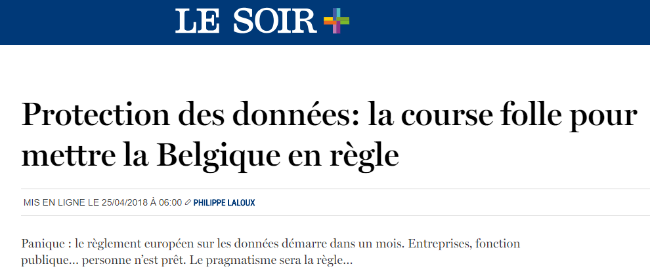
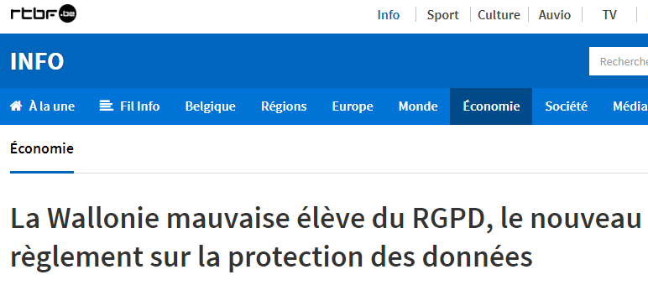
Problem?

Slide 5
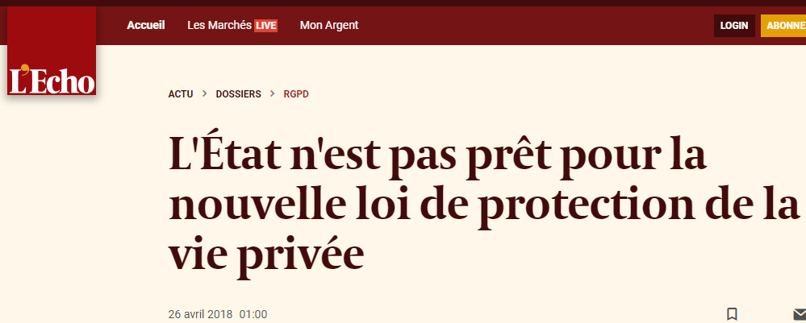
Problem?

Slide 6
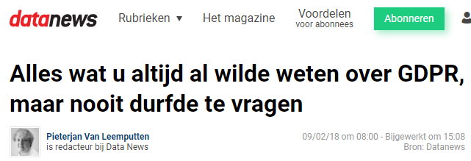
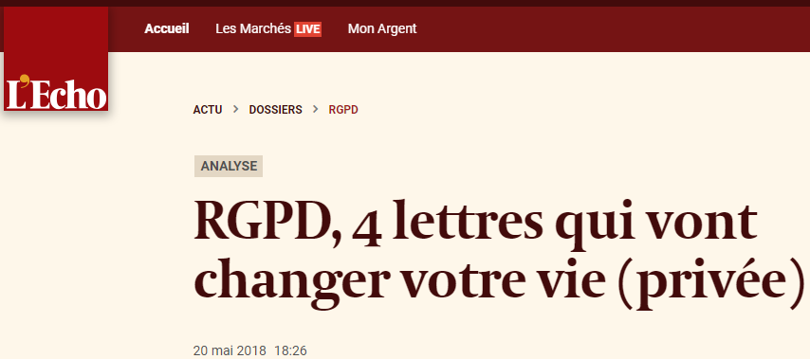
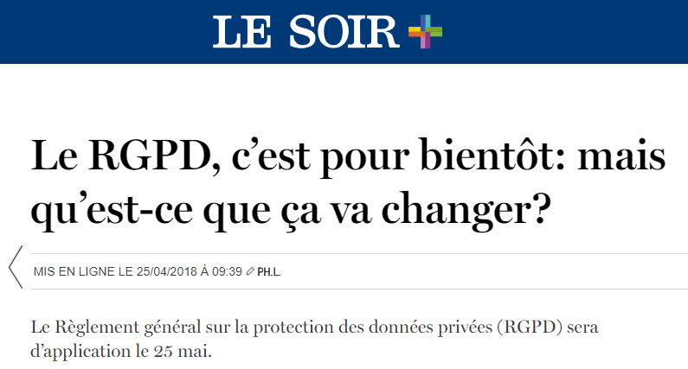
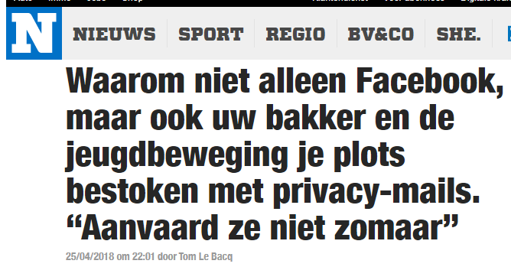
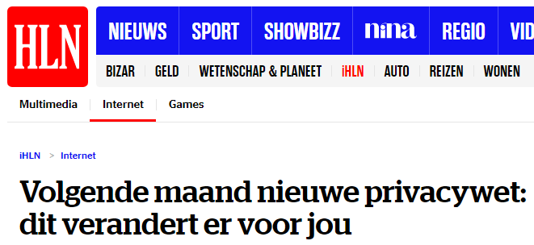
Media Attention

Slide 7
Organisations vs. Data subjects
We are not ready!
Just a bit longer and we will be.
I will exercise my rights, ready or not!

Slide 8
Problem?

Slide 9
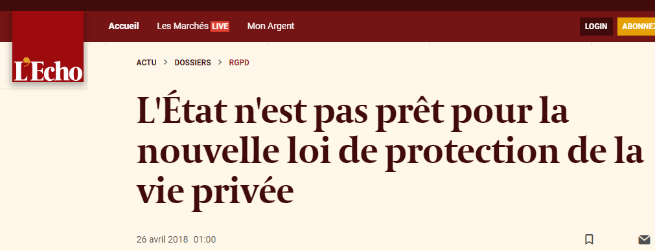
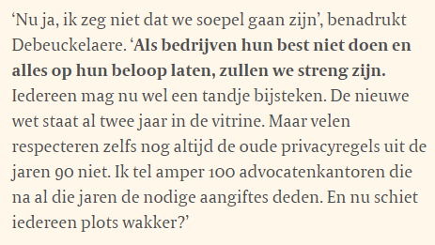
Problem?

Slide 10
What’s missing still?
Guidelines on certification
Clarity on exception for journalists (press freedom)
Sectorial codes of conduct
Transformation of the rules into criminal law
Framework law
Transformation of the privacy commission into DPA

Slide 11
Framework law

Slide 12
GDPR
In a nutshell

Slide 13
GDPR principles
Personal Data Principles
Lawfulness, fairness & transparency
Data Minimisation
Accuracy
Purpose Limitation
Storage Limitation
Secured
Additional guarantees with data transfers out of EU
Respect Data Subject Rights

Slide 14
Key concepts and definitions
Personal Data
Any information relating to an identified or identifiable natural person (‘data subject’);
an identifiable natural person is one who can be identified, directly or indirectly, in particular by reference to an identifier such as a name, an identification number, location data, an online identifier or to one or more factors specific to the physical, physiological, genetic, mental, economic, cultural or social identity of that natural person.
Personal data can be divided into 2 categories:
Standard personal data
First name, last name, street names, telephone numbers, ip-adresses,…
Sensitive personal data
Certain data must have extra protection because they can harm the personality or physical integrity of an individual.

Slide 15
Key concepts and definitions
Controller
The natural or legal person, public authority, agency or other body which, alone or jointly with others, determines the purposes and means of the processing of personal data.
Processor
A natural or legal person, public authority, agency or other body which processes personal data on behalf of the controller.
Processing
Any operation or set of operations which is performed on personal data or on sets of personal data, whether or not by automated means, such as collection, recording, organisation, structuring, storage, adaptation or alteration, retrieval, consultation, use, disclosure by transmission, dissemination or otherwise making available, alignment or combination, restriction, erasure or destruction.

Slide 16
Accountability & Transparency
Accountable
The controller shall be responsible for, and be able to demonstrate compliance with the GDPR legislation
Transparency
The controller shall take appropriate measures to provide any information and communication relating to processing to the data subject in a concise, transparent, intelligible and easily accessible form, using clear and plain language.
Adherence to approved codes of conduct or approved certification mechanisms may be used as an element by which to demonstrate compliance
Key documents:
Register of Processing activities (a.k.a. dataregister)
Data Protection Impact Assessments (DPIA)
Privacy Policy & Privacy Notice

Slide 17
Data breach notification
Art 33 §1 In the case of a personal data breach, the controller shall without undue delay and, where feasible, not later than 72 hours after having become aware of it, notify the personal data breach to the supervisory authority competent in accordance with Article 55, unless the personal data breach is unlikely to result in a risk to the rights and freedoms of natural persons (…)
Art 33 §5 The controller shall document any personal data breaches, comprising the facts relating to the personal data breach, its effects and the remedial action taken. (…)
Take mitigating measures
Information to data subject in some circumstances

Slide 18
Rights of the Data Subject
Right to transparantie (verstrengd)
Right to access
Right to rectification
Right to erasure a.k.a. ‘Right to be forgotten’ (new)
Right to restriction of processing (new)
Right to portability (new)

Slide 19
GDPR
So what to do?

Slide 20
Help!

Slide 21
Most urgent?

